Slide 1

EDA
Module 6CM521: Frontiers in AI and Data Science
Ioannis Tsioulis (MC)
Slides acknowledgements:
Dr Hong Qing Yu

Slide 2
Declaration
These lecture notes are based on the book Doing Data Science, Chapter 2, EDA section

Slide 3
EDA is an attitude
“Exploratory data analysis” is an attitude, a state of flexibility, a willingness to look for those things that we believe are not there, as well as those we believe to be there.
— John Tukey

Slide 4
What is EDA?
Exploratory Data Analysis (EDA) is an approach/philosophy for data analysis that employs a variety of techniques (mostly graphical) to
maximize insight into a data set;
uncover underlying structure;
extract important variables;
detect outliers and anomalies;
test underlying assumptions;
develop parsimonious models; and
determine optimal factor settings.

Slide 5
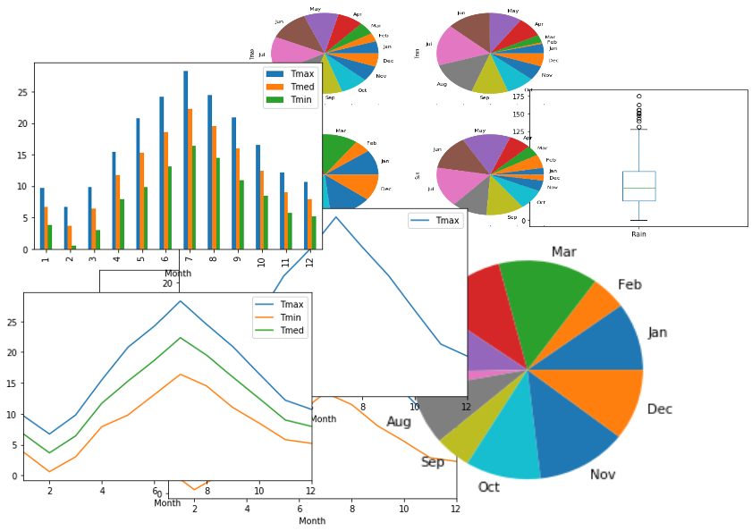
Tools of EDA
The basic tools of EDA are plots, graphs and summary statistics (e.g. data distributions).
Notes:
Generally speaking, it’s a method of systematically going through the data, plotting distributions of all variables (using box plots), plotting time series of data, transforming variables, looking at all pairwise relationships between variables using scatterplot matrices, and generating summary statistics for all of them.
At the very least that would mean computing their mean, minimum, maximum, the upper and lower quartiles, and identifying outliers.

Slide 6
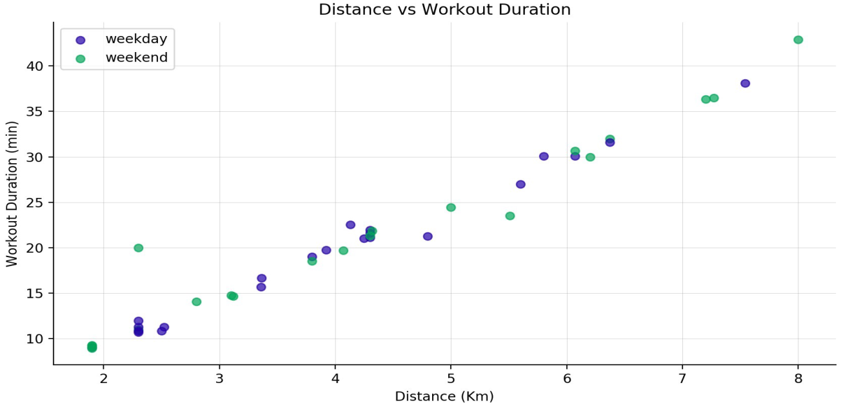
EDA Mindset
But as much as EDA is a set of tools, it’s also a mindset. And that mindset is about your relationship with the data.
EDA happens between you and the data and isn’t about proving anything to anyone else yet.
Notes:
You want to understand the data—gain intuition, understand the shape of it, and try to connect your understanding of the process that generated the data to the data itself.

Slide 7
Philosophy of EDA
Long before worrying about how to convince others, you first have to understand what’s happening yourself.
— Andrew Gelman
Even with very large Google-scale data, they did EDA.
In the context of data in an Internet/engineering company, EDA is done for some of the same reasons it’s done with smaller datasets, but there are additional reasons to do it with data that has been generated from logs.

Slide 8
Philosophy of EDA (Cont.)
There are important reasons anyone working with data should do EDA. Namely, to gain intuition about the data; to make comparisons between distributions; for sanity checking (making sure the data is on the scale you expect, in the format you thought it should be); to find out where data is missing or if there are outliers; and to summarize the data.
In the context of data generated from logs, EDA also helps with debugging the logging process. For example, “patterns” you find in the data could actually be something wrong in the logging process that needs to be fixed. If you never go to the trouble of debugging, you’ll continue to think your patterns are real. The engineers we’ve worked with are always grateful for help in this area.
In the end, EDA helps you make sure the product is performing as intended.

Slide 9
Who are they?
John Tukey, a mathematician at Bell Labs, developed exploratory data analysis in contrast to confirmatory data analysis, which concerns itself with modelling and hypotheses.
Exploratory Data Analysis by John Tukey (Pearson)
“Exploratory Data Analysis for Complex Models” by Andrew Gelman (American Statistical Association)

Slide 10
6 steps to do your EDA
Import Dataset & Headers
Organizing your data (Correct Data Formats)
3.1. Identify Missing Data
3.2 Replace Missing Data
3.3 Evaluate Missing Data
3.4 Dealing with Missing Data
4. Indicator variable
5. Data standardization
6. Data Normalization
Data pre-processing

Slide 11
What is data?
Categorical (Qualitative)
    Nominal scales – number is just a symbol that identifies a quality
      0=male, 1=female
      1=green, 2=blue, 3=red, 4=white
    Ordinal – rank order
Quantitative (continuous and discrete)
    Interval – units are of identical size (e.g. years)
    Ratio – distance from an absolute zero (e.g. age, reaction time)

Slide 12
What is a measurement?
Every measurement has 2 parts:
The True Score (the actual state of things in the world)
and
ERROR! (mistakes, bad measurement, report bias, context effects, etc.)
X = T + e

Slide 13
Organizing your data in a spreadsheet
Stacked data:
Multiple cases (rows) for each subject
Unstacked data:
Only one case (row) per subject
Subject | condition | score
1 | before | 3
1 | during | 2
1 | after | 5
2 | before | 3
2 | during | 8
2 | after | 4
3 | before | 3
3 | during | 7
3 | after | 1
Subject | before | during | after
1 | 3 | 2 | 5
2 | 3 | 8 | 4
3 | 3 | 7 | 1

Slide 14
Handling missing data
Removing missing data
If data are missing completely at random (MCAR) and only a small fraction of observations have missing values, it may be safe to remove them
Encoding as missing
In the MCAR or MAR (missing at random) case for categorical attributes y, a useful approach is to encode the fact that a value is missing as a new category and include that in subsequent analysis of attribute y.
Imputation
  MCAR (also for MAR, but this is not ideal). In this case we can use a simple method for imputation of y. For numeric attributes we replace missing values in y with the mean of non-missing values of y.
  Predictive model for MAR. In this case we use a more complex method: we replace missing values of attribute y with values predicted from other variables x when the variables are related (e.g. linear regression).

Slide 15
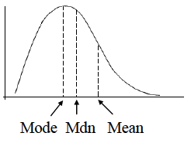
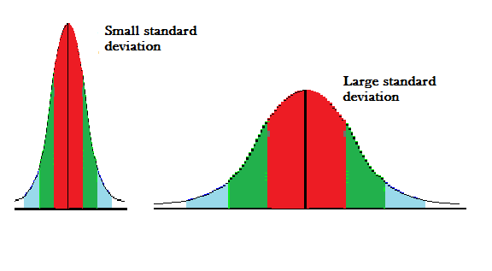
Variable Summaries
Indices of central tendency:
  Mean – the average value
  Median – the middle value
  Mode – the most frequent value
Indices of Variability:
  Variance – the spread around the mean
  Standard deviation
  Standard error of the mean (estimate)
Count
value
mean

Slide 16
The Mean
Subject | before | during | after
1 | 3 | 2 | 7
2 | 3 | 8 | 4
3 | 3 | 7 | 3
4 | 3 | 2 | 6
5 | 3 | 8 | 4
6 | 3 | 1 | 6
7 | 3 | 9 | 3
8 | 3 | 3 | 6
9 | 3 | 9 | 4
10 | 3 | 1 | 7
Mean = sum of all scores divided by number of scores
X₁ + X₂ + X₃ + … + X_{n}
n
Sum = 30 50 50
/n 10 10 10
Mean = 3 5 5

Slide 17
The Variance: Sum of the squared deviations divided by number of scores
Subject | before | during | after
1 | 3 | 2 | 7
2 | 3 | 8 | 4
3 | 3 | 7 | 3
4 | 3 | 2 | 6
5 | 3 | 8 | 4
6 | 3 | 1 | 6
7 | 3 | 9 | 3
8 | 3 | 3 | 6
9 | 3 | 9 | 4
10 | 3 | 1 | 7
Before -mean | Before – mean ² | During - mean | During – mean² | After - mean | After – mean ²
0 | 0 | -3 | 9 | 2 | 4
0 | 0 | 3 | 9 | -1 | 1
0 | 0 | 2 | 4 | -2 | 4
0 | 0 | -3 | 9 | 1 | 1
0 | 0 | 3 | 9 | -1 | 1
0 | 0 | -4 | 16 | 1 | 1
0 | 0 | 4 | 16 | -2 | 4
0 | 0 | -2 | 4 | 1 | 1
0 | 0 | 4 | 16 | -1 | 1
0 | 0 | -4 | 16 | 2 | 4
Sum = 30 50 50
/n 10 10 10
Mean = 3 5 5
0 0 0 108 0 22
10* 10 10
VAR = 0 10.8 2.2
*actually you divide by n-1 because it is a sample and not a population, but you get the idea…

Slide 18
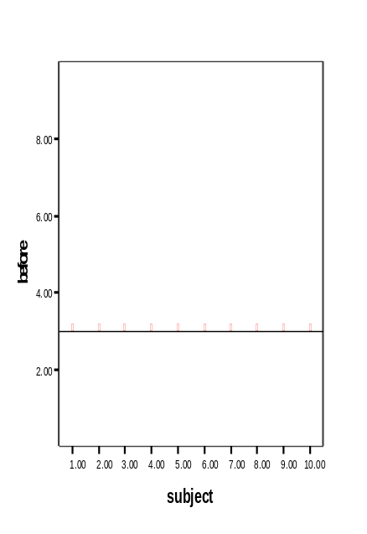
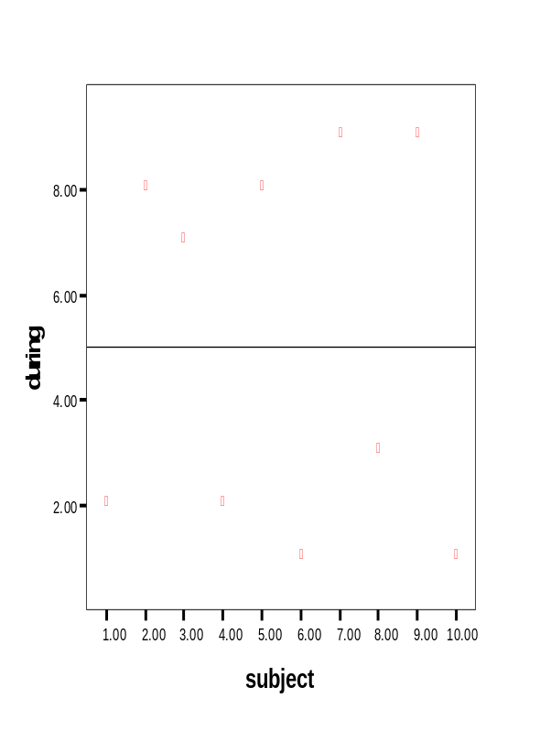
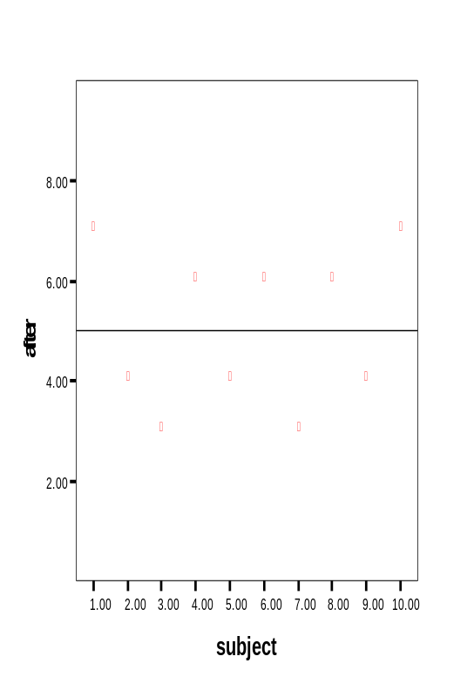
Variance continued
mean

Slide 19
Standard deviation calculation
The process of standardizing deviations goes like this:
1.Score (in the units that are meaningful)
2.Mean
3.Each score’s deviation from the mean
4.Square that deviation
5.Sum all the squared deviations (Sum of Squares)
6.Divide by n (if population) or n-1 (if sample)
7.Square root – now the value is in the units we started with!!!

Slide 20
Standardize Variance
Variance, as calculated earlier, is arbitrary.
What does it mean to have a variance of 10.8? Or 2.2? Or 1459.092? Or 0.000001?
Nothing. But if you could “standardize” that value, you could talk about any variance (i.e. deviation) in equivalent terms.
Standard Deviations are simply the square root of the variance

Slide 21
Distribution
Means and variances are ways to describe a distribution of scores/values.
Knowing about your distributions is one of the best ways to understand your data
A NORMAL (aka Gaussian) distribution is the most common assumption of statistics, thus it is often important to check if your data are normally distributed.
We will discuss the Gaussian distribution further in the ML part.

Slide 22
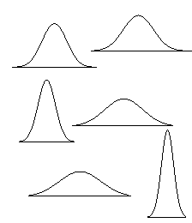
Interpreting standard deviation (SD)
First, the SD will let you know about the distribution of scores around the mean.
High SDs (relative to the mean) indicate the scores are spread out
Low SDs tell you that most scores are very near the mean.
High SD
Low SD

Slide 23
Standardized scores (Z)
Then, you can use SDs to create standardized scores – that is, put each score into units of SD. This changes the scale, not the shape of the distribution.
Subtract the mean from each score and divide by SD
Z = (X – mean)/SD
This is truly an amazing thing

Slide 24
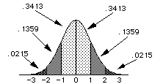
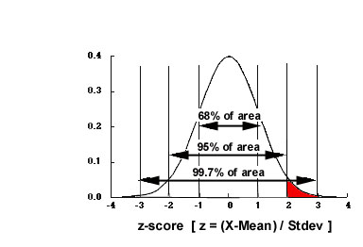
Standardized normal distribution
ALL Z-scores have a mean of 0 and SD of 1. Nice and simple.
If the data are normally distributed, we can get the proportion of scores anywhere in the distribution.

Slide 25
The trouble with normal
We violate assumptions about statistical tests if the distributions of our variables are not approximately normal.
Thus, we must first examine each variable’s distribution and make adjustments when necessary so that assumptions are met.
More types of distribution need to be considered.

Slide 26
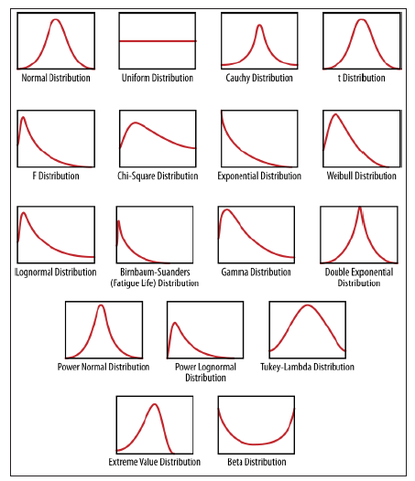
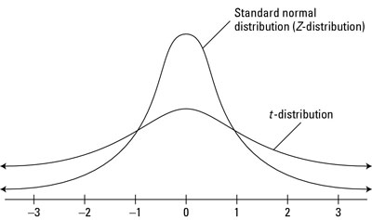
A bunch of continuous probability distributions

Slide 27
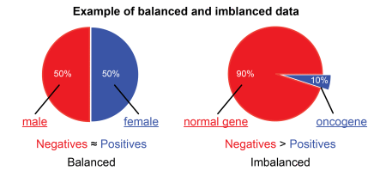
Checking data balance

Slide 28
Visual display of univariate data
Now the example data from before has decimals
(what kind of data is that?)
Precision has increased
Subject | before | during | after
1 | 3.1 | 2.3 | 7
2 | 3.2 | 8.8 | 4.2
3 | 2.8 | 7.1 | 3.2
4 | 3.3 | 2.3 | 6.7
5 | 3.3 | 8.6 | 4.5
6 | 3.3 | 1.5 | 6.6
7 | 2.8 | 9.1 | 3.4
8 | 3 | 3.3 | 6.5
9 | 3.1 | 9.5 | 4.1
10 | 3 | 1 | 7.3

Slide 29
Visual display of univariate data (Cont.)
Histograms
Stem and Leaf plots
Boxplots
QQ Plots
…and many many more
Subject | before | during | after
1 | 3.1 | 2.3 | 7
2 | 3.2 | 8.8 | 4.2
3 | 2.8 | 7.1 | 3.2
4 | 3.3 | 2.3 | 6.7
5 | 3.3 | 8.6 | 4.5
6 | 3.3 | 1.5 | 6.6
7 | 2.8 | 9.1 | 3.4
8 | 3 | 3.3 | 6.5
9 | 3.1 | 9.5 | 4.1
10 | 3 | 1 | 7.3

Slide 30
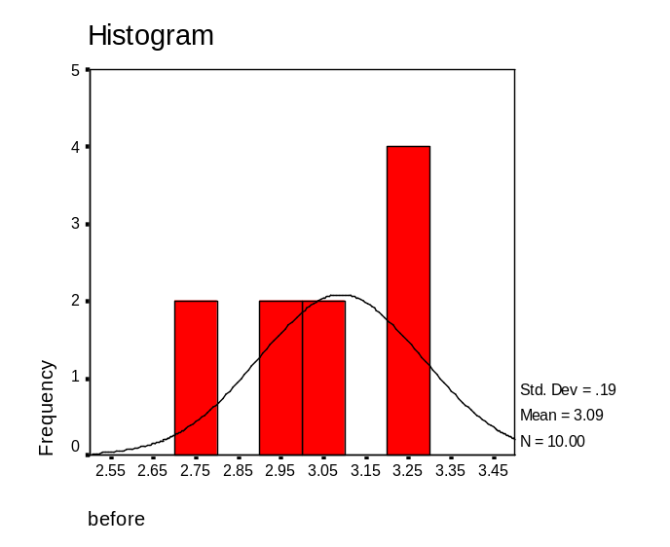
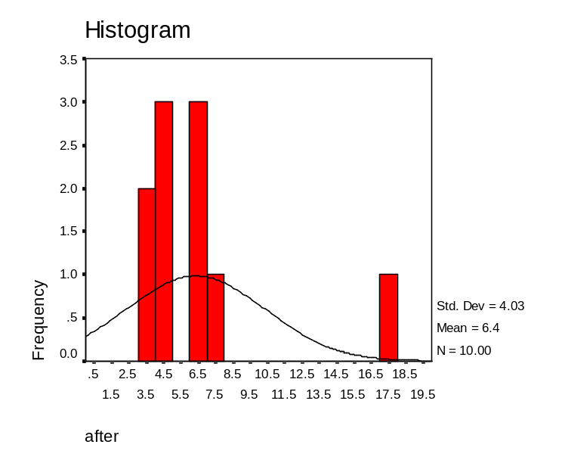
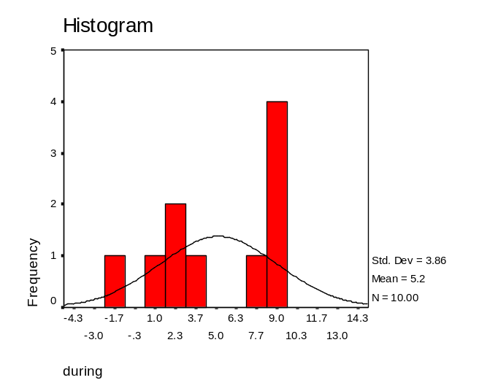
Histograms
# of bins is very important

Slide 31
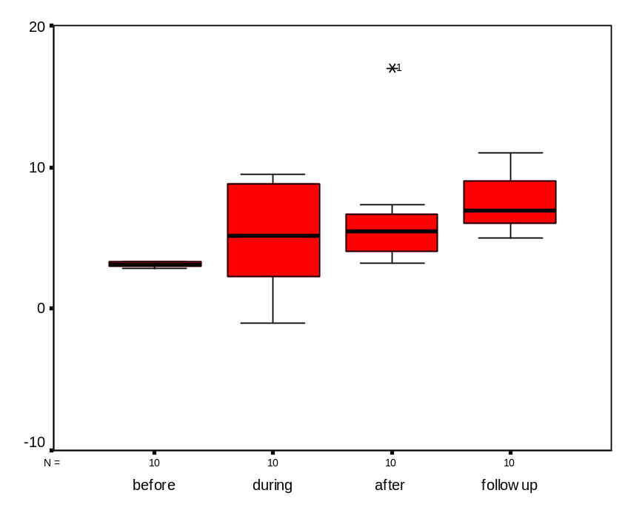
Boxplots
Upper and lower bounds of boxes are the 25th and 75th percentile (interquartile range)
Whiskers are min and max value unless there is an outlier
An outlier is beyond 1.5 times the interquartile range (box length)

Slide 32
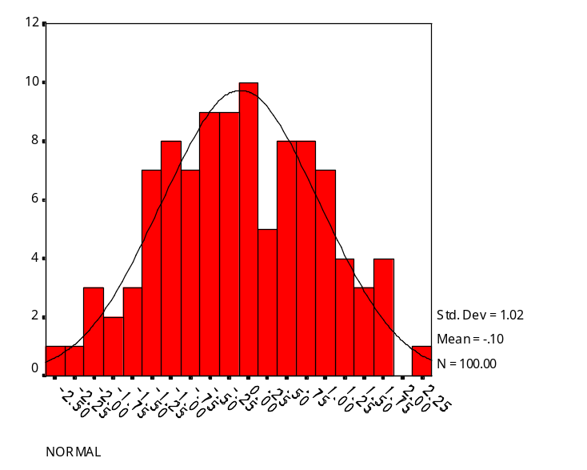
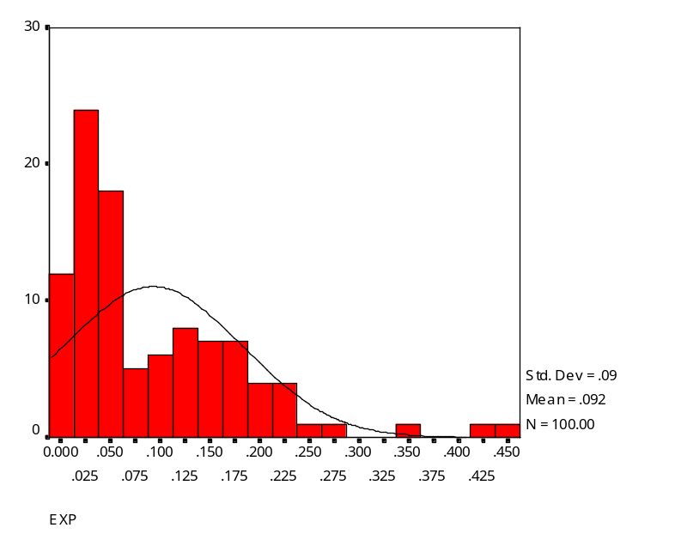
Quantile-Quantile (Q-Q) Plots
The quantile-quantile (q-q) plot is a graphical technique for determining if two data features or sets come from populations with a common distribution.
Random Normal Distribution Random Exponential Distribution
Vertical axis: Estimated quantiles from data feature 1
Horizontal axis: Estimated quantiles from data feature 2

Slide 33
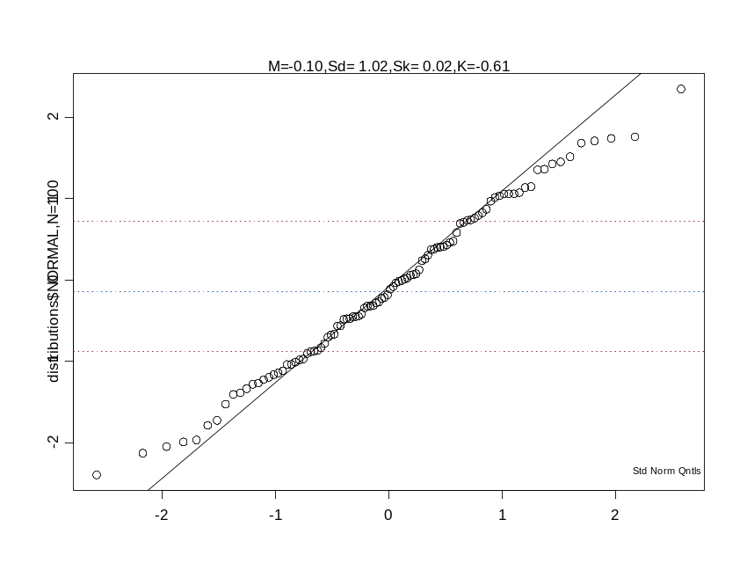
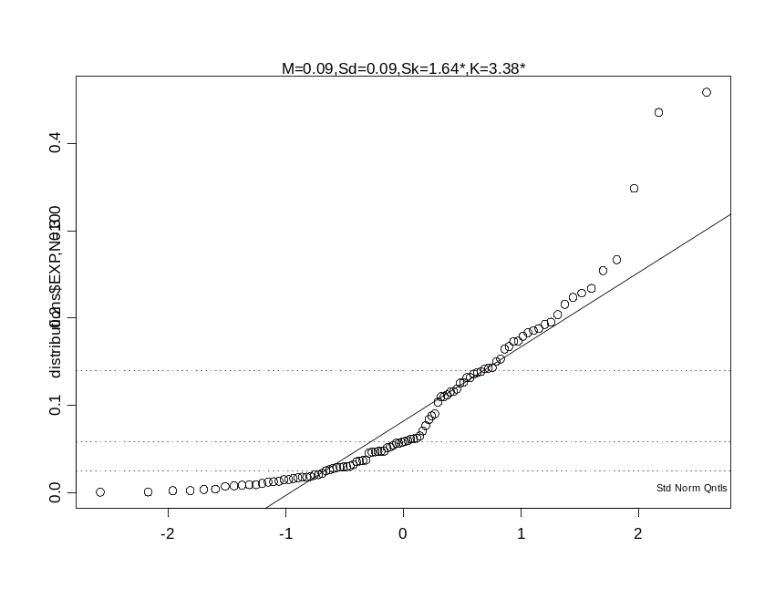
Q-Q Plots

Slide 34
So…what do you do with EDA?
If you find a mistake, fix it.
If you find an outlier, trim it or delete it.
If your distributions are skewed, transform the data.

Slide 35
Dealing with Outliers
First, try to explain it.
In a normal distribution about 0.7% are outliers (beyond ±2.7 SD) and about 2 in a million are extreme outliers (beyond ±4.72 SD).
For analyses you can:
Delete the value – crude but effective
Change the outlier to value ~3 SD from mean
“Winsorize” it (make = to next highest value)
“Trim” the mean – recalculate mean from data within interquartile range

Slide 36
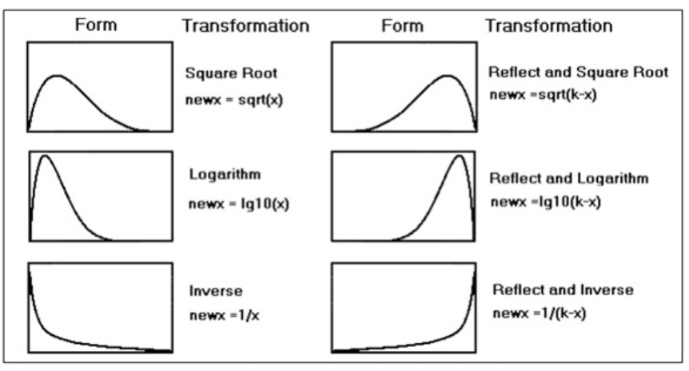
Dealing with skewed distributions
(Skewness and kurtosis greater than +/- 2)

Slide 37
Visual Display of Bivariate Data
So, you have examined each variable for mistakes, outliers and distribution and made any necessary alterations. Now what?
Look at the relationship between 2 (or more) variables at a time

Slide 38
Visual Displays of Bivariate Data
Variable 1 | Variable 2 | Display Example
Categorical | Categorical | Crosstabs
Categorical | Continuous | Box plots
Continuous | Continuous | Scatter plots

Slide 39
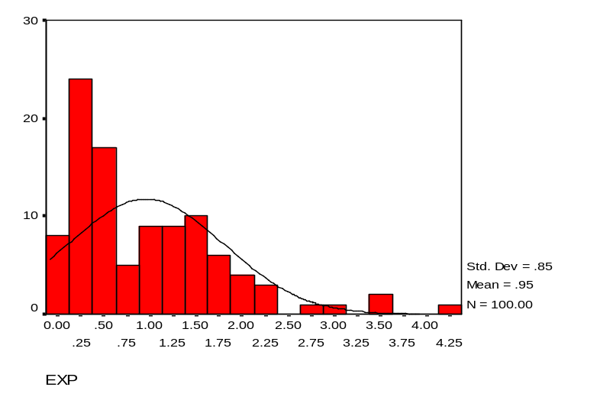
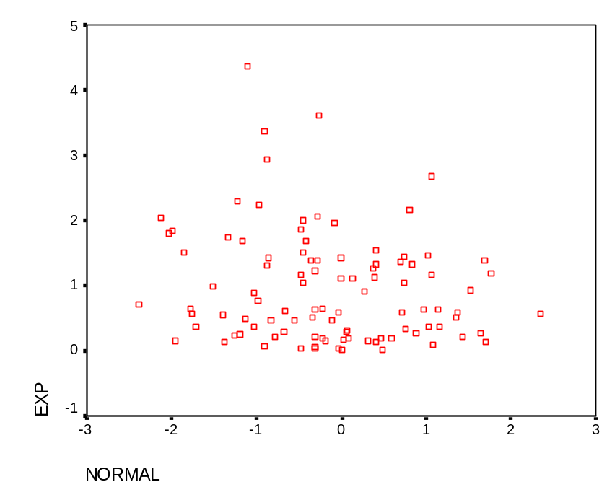
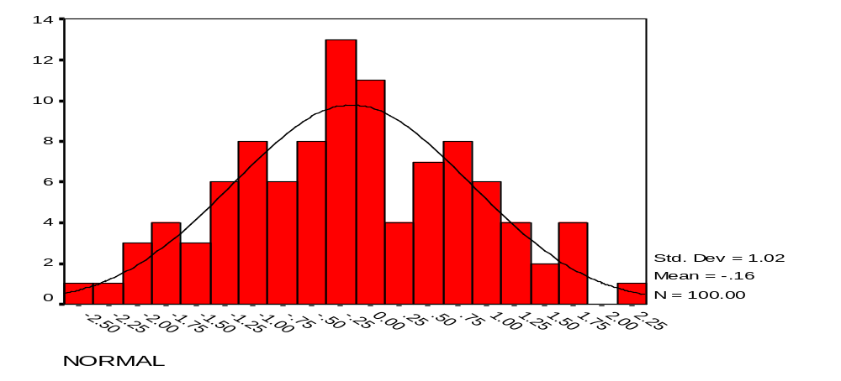
Bivariate Distribution

Slide 40
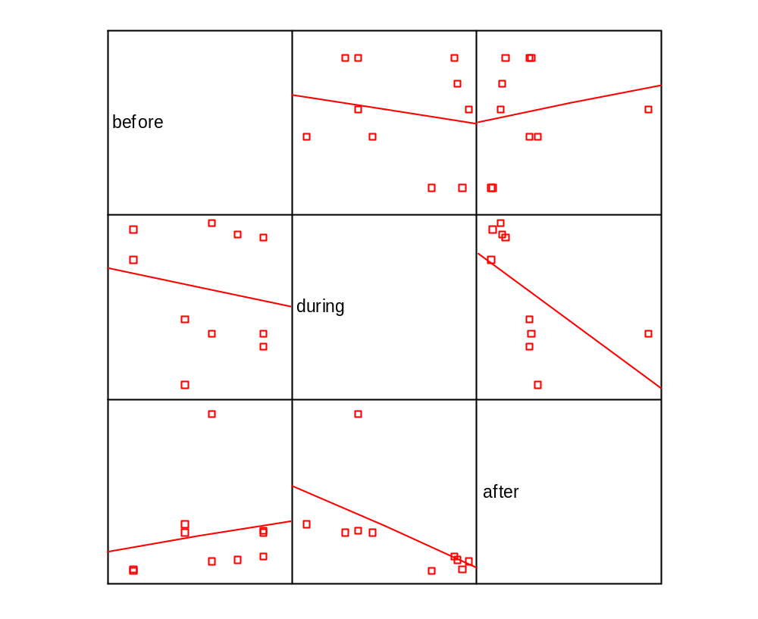
Intro to Scatter plots
Scatter plots use dots to represent values for two different numeric variables. The position of each dot on the horizontal and vertical axis indicates values for an individual data point. Scatter plots are used to observe relationships between variables.

Slide 41
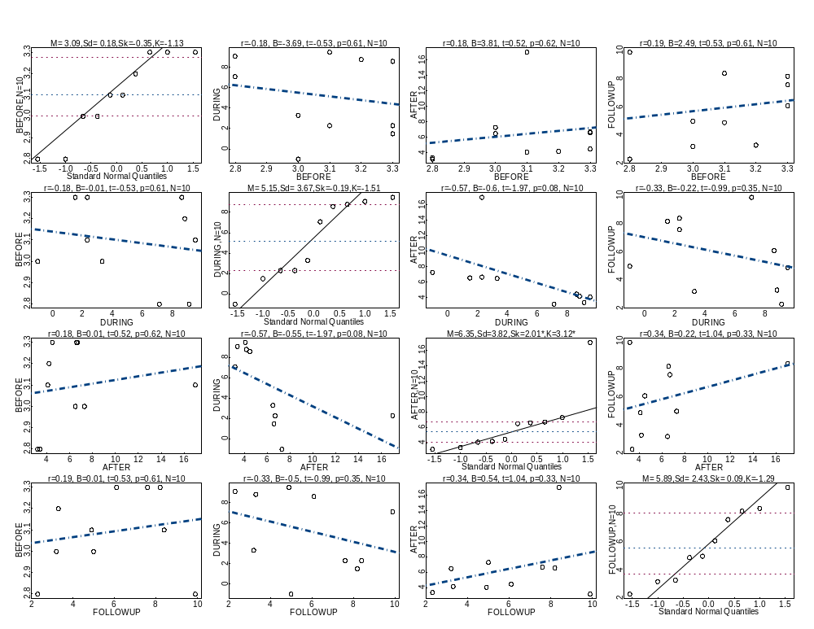

Slide 42
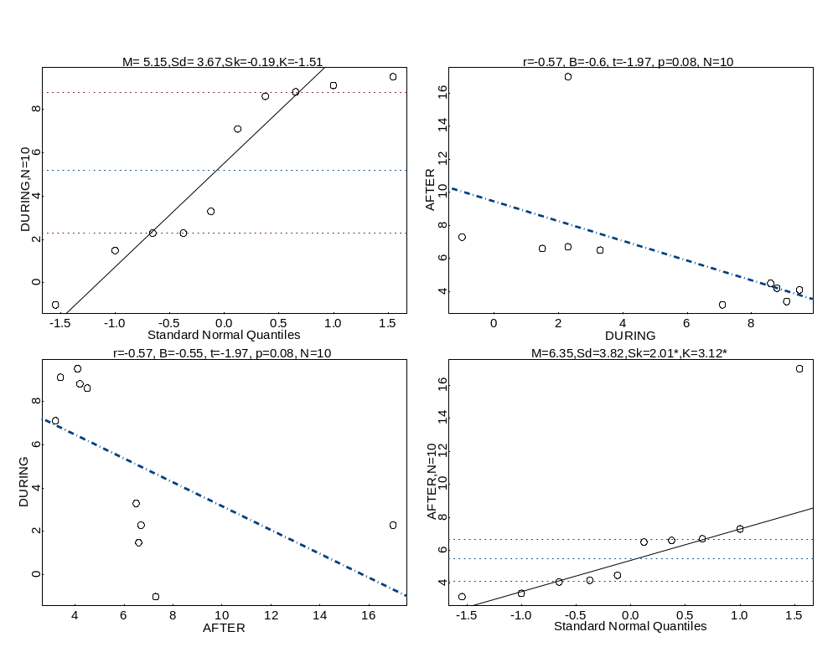
With Outlier and Out of Range Value

Slide 43
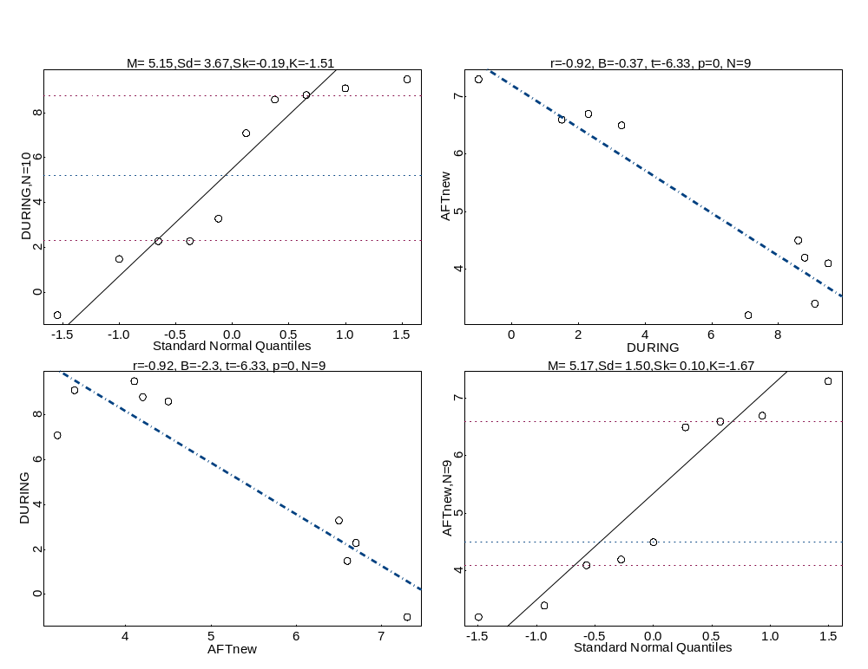
Without Outlier

Slide 44
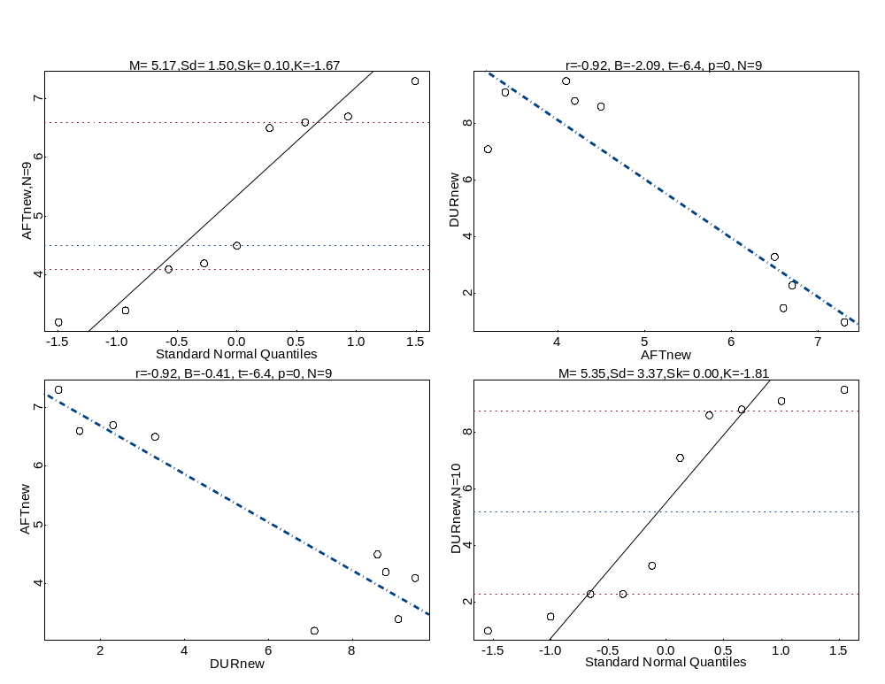
With Corrected Out of Range Value

Slide 45
Scales of Graphs
It is very important to pay attention to the scale that you are using when you are plotting.
Compare the following graphs created from identical data

Slide 46
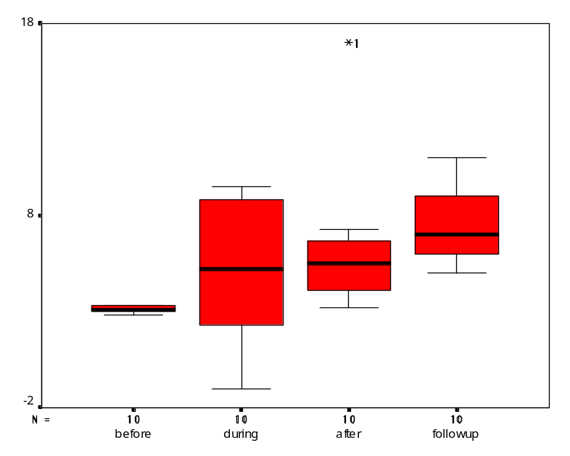
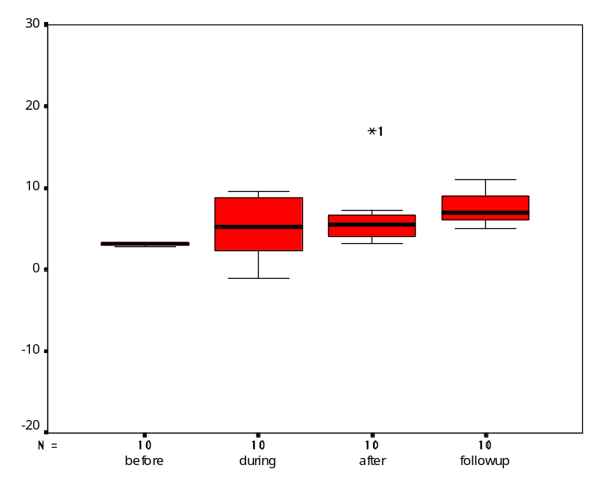
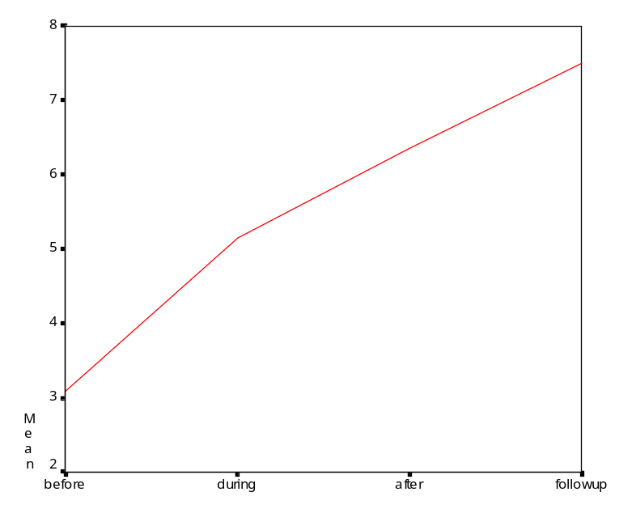
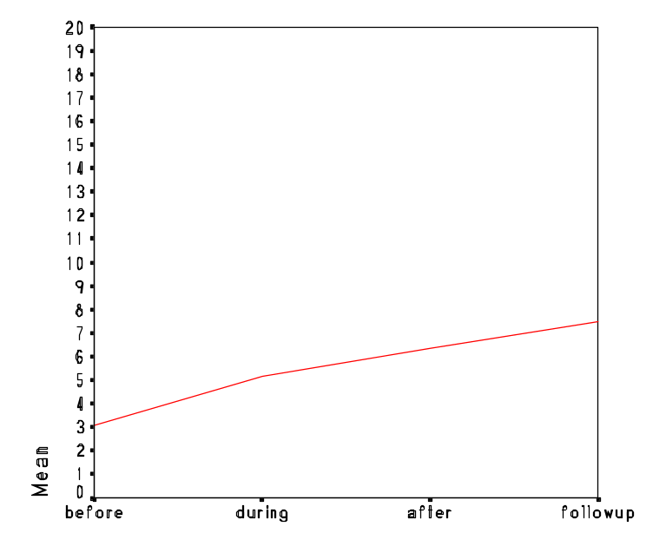

Slide 47
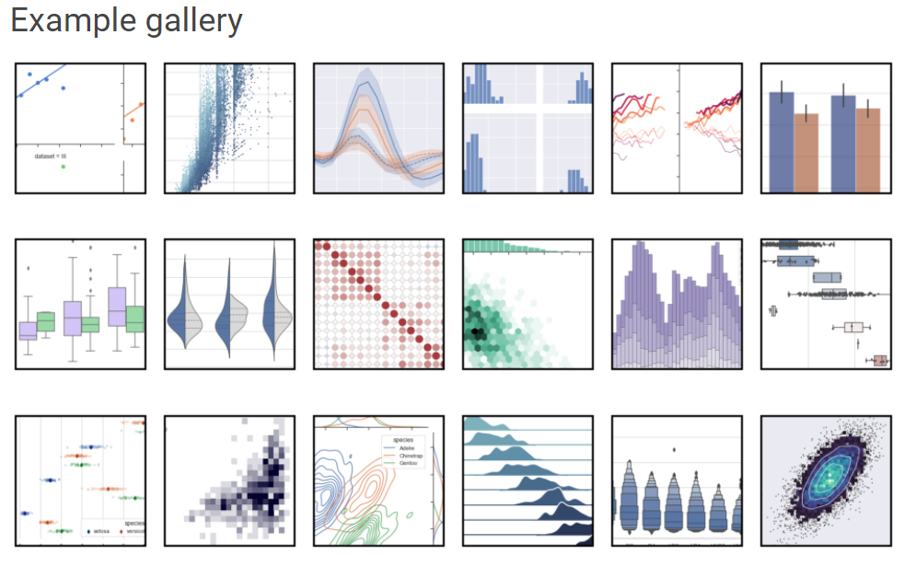
Python visualisation tools
Matplotlib (https://matplotlib.org/)
Seaborn (https://seaborn.pydata.org/)

Slide 48
Summary
Examine all your variables thoroughly and carefully before you begin analysis
Use visual displays whenever possible
Transform each variable as necessary to deal with mistakes, outliers, and distributions
Let’s practise on the course website
Homework: read Chapter 2 of Doing Data Science
Next week:
Lecture: start mining the data for frequent patterns
Practices: Association rule mining for frequent patterns

Slide 49
More references
1. Exploratory Data Analysis by John Tukey (Pearson)
2. The Visual Display of Quantitative Information by Edward Tufte (Graphics Press)
3. The Elements of Graphing Data by William S. Cleveland (Hobart Press)
4. Statistical Graphics for Visualizing Multivariate Data by William G. Jacoby (Sage)
5. “Exploratory Data Analysis for Complex Models” by Andrew Gelman (American Statistical Association)
6. The Future of Data Analysis by John Tukey. Annals of Mathematical Statistics, Volume 33, Number 1 (1962), 1-67.
7. Data Analysis, Exploratory by David Brillinger [8-page excerpt from International Encyclopedia of Political Science (Sage)]
8. https://www.hcbravo.org/IntroDataSci/bookdown-notes/eda-handling-missing-data.html

